Slide 1
Store Item Demand Forecasting Using Deep Learning Approach
Presented by
Safwan Muntasir 180104084
Mashfiq Rahman 180104087
Arifur Rahman Jawad 180104097
Abdullah Al Mohaimen 180104098
Ashfakur Fahim 160204032

Slide 2
CONTENTS
31 August, 2022
Introduction
Motivation
Related Works
Dataset
Methodology
Experimental Result
Future Work
Conclusion

Slide 3
INTRODUCTION
31 August, 2022
Vast amount of store.
Lack of knowledge of product demand.
Problem: waste of space for demandless product.

Slide 4
MOTIVATION
31 August, 2022
Financial benefit.
Efficient use of warehouse.
More profit less waste.
Maintaining market flow by maintaining demand.

Slide 5
OBJECTIVE
31 August, 2022
Form a dataset.
Choose efficient model.
Compare results.
Come to a conclusion.

Slide 6
RELATED WORKS
31 August, 2022
A Retail Demand Forecasting Model Based on Data Mining Techniques.
SKU demand forecasting in the presence of promotions.
Machine learning demand forecasting and supply chain performance.
Inventory Management using Machine Learning.
Model of the Automated Warehouse Management and Forecasting System in the Conditions of Transitionto Industry 4.0.

Slide 7
DATASET
31 August, 2022
Dataset source: Kaggle
Total number of data 10,48,576
Number of dataset paths 6
Dataset with 5 features
Data pre-processing-
Handle missing data
Formating data

Slide 8
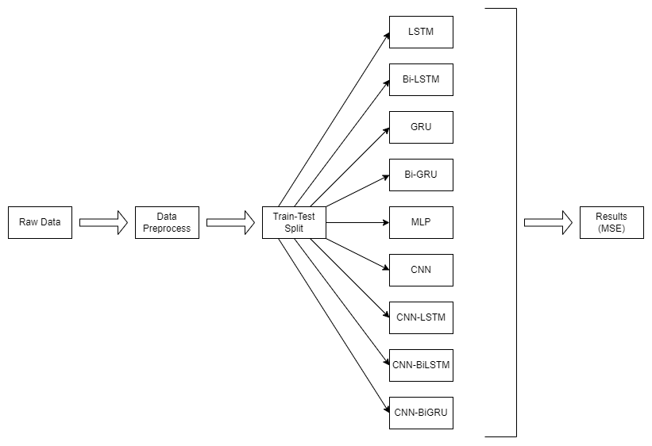
METHODOLOGY
31 August, 2022

Slide 9
EXPERIMENTAL RESLUTS
31 August, 2022
Model name | Mean Squared Error (MSE)
MLP | 19.0906
CNN | 21.6758
LSTM | 29.6026
GRU | 29.4742
BiLSTM | 29.2528
BiGRU | 29.3320
CNN-LSTM | 27.6175
CNN-BiLSTM | 26.8782
CNN-BiGRU | 26.6248

Slide 10
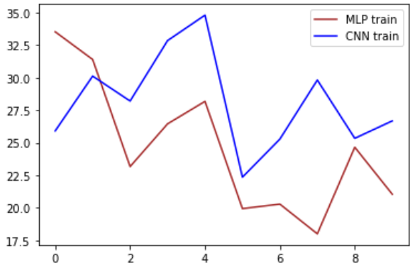
EXPERIMENTAL RESLUTS
31 August, 2022
Fig 1: Loss Curve for MLP & CNN

Slide 11
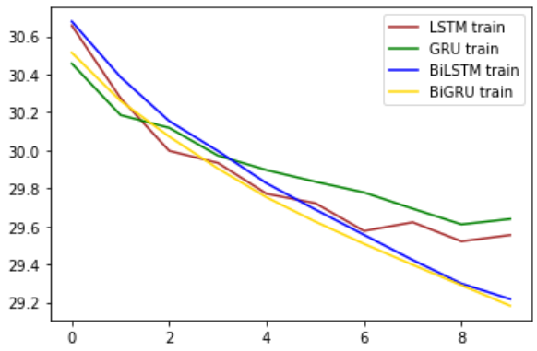
EXPERIMENTAL RESLUTS
31 August, 2022
Fig 2: Loss Curve for LSTM, GRU, BiLSTM & BiGRU

Slide 12
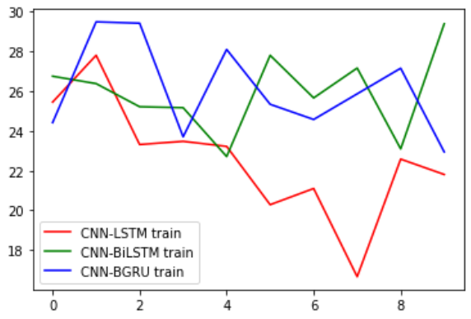
EXPERIMENTAL RESLUTS
31 August, 2022
Fig 3: Loss Curve for Different Combination of CNN

Slide 13
FUTURE WORKS
31 August, 2022
Data increase
Increasing area of product

Slide 14
CONCLUSION
31 August, 2022
After forming a efficient dataset from the data we found from other related works, running it through the selected deep learning models and analyzing the results, we have found out that MLP is the best model for our prediction.

Slide 15
THANKS!
Any questions?

